Slide 1
Employee monthly pay slip
Prepared For
Candice Nel Development Manager MYOB NZ Limited
Prepared by
19-Dec-2015
Madhavan

Slide 2
problem
When I input the employee's details: first name, last name, annual salary(positive integer) and super rate(0% - 50% inclusive), payment start date, the program should generate payslip information with name, pay period, gross income, income tax, net income and super.
The calculation details will be the following: • pay period = per calendar month • gross income = annual salary / 12 months • income tax = based on the tax table provide below • net income = gross income - income tax • super = gross income x super rate
Notes: All calculation results should be rounded to the whole dollar. If >= 50 cents round up to the next dollar increment, otherwise round down. The following rates for 2012-13 apply from 1 July 2012.
Taxable income Tax on this income 0 - $18,200 Nil $18,201 - $37,000 19c for each $1 over $18,200 $37,001 - $80,000 $3,572 plus 32.5c for each $1 over $37,000 $80,001 - $180,000 $17,547 plus 37c for each $1 over $80,000 $180,001 and over $54,547 plus 45c for each $1 over $180,000 The tax table is from ATO: http://www.ato.gov.au/content/12333.htm
Example Data
Employee annual salary is 60,050, super rate is 9%, how much will this employee be paid for the month of March ? • pay period = Month of March (01 March to 31 March) • gross income = 60,050 / 12 = 5,004.16666667 (round down) = 5,004 • income tax = (3,572 + (60,050 - 37,000) x 0.325) / 12 = 921.9375 (round up) = 922 • net income = 5,004 - 922 = 4,082 • super = 5,004 x 9% = 450.36 (round down) = 450
Here is the csv input and output format we provide. (But feel free to use any format you want) Input (first name, last name, annual salary, super rate (%), payment start date): David,Rudd,60050,9%,01 March – 31 March Ryan,Chen,120000,10%,01 March – 31 March Output (name, pay period, gross income, income tax, net income, super): David Rudd,01 March – 31 March,5004,922,4082,450 Ryan Chen,01 March – 31 March,10000,2696,7304,1000

Slide 3
List any assumptions.
Employees are Australian Residential
Income Tax Year 2015

Slide 4
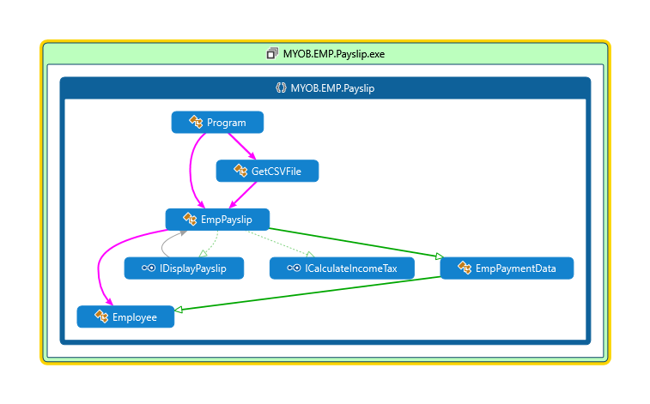
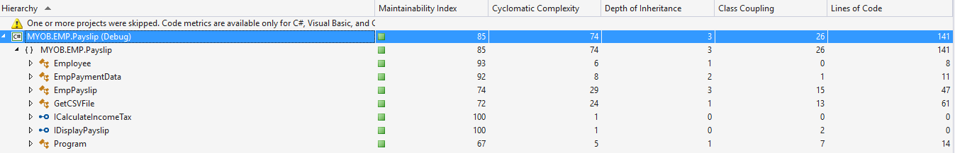
Code map and Code metrix

Slide 5
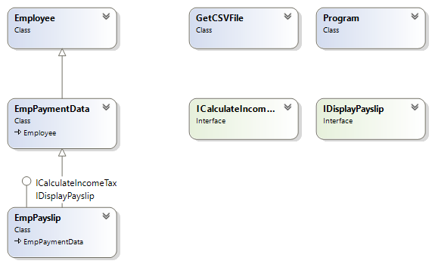
Class diagram

Slide 6
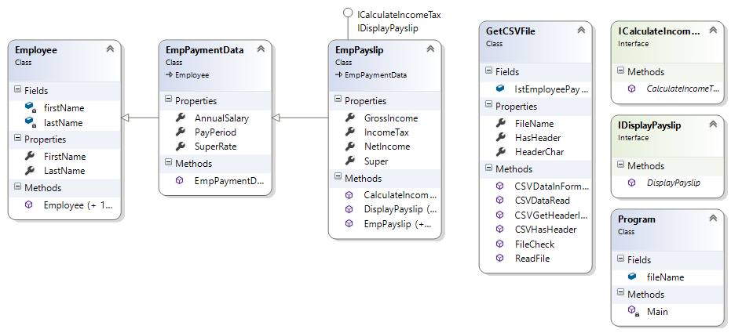
Class with properties and Methods

Slide 7
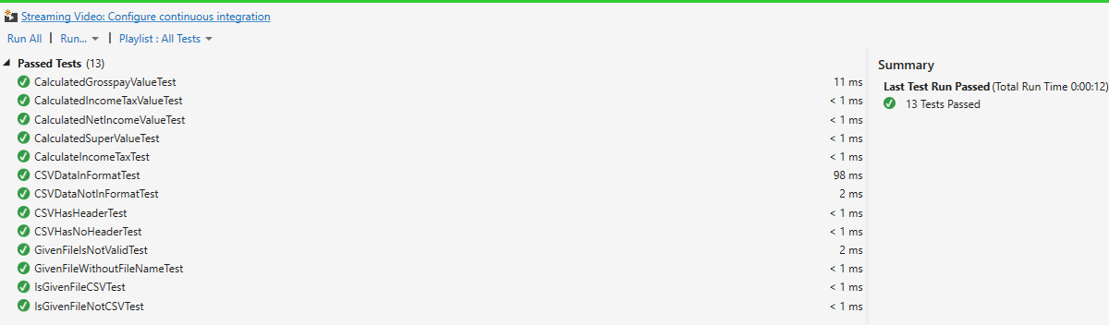
Test cases

